Slide 1

Automated Meeting Room Booking Application
Welcome to the future of meeting room bookings. Discover the key features and benefits of our automated system and revolutionize the way you schedule and manage meetings.
By team- Scared To Compile

Slide 2

Meet Our Team
1
Likhitha Kanduvada
2
Sayanthan Das
3
Anish Gudimetla
4
Shivangi Singh
5
Surya Manjunathan G
6
Shambavi Narulkar
7
8
Ruchika Jaiswal
Reema Dhanwani

Slide 3
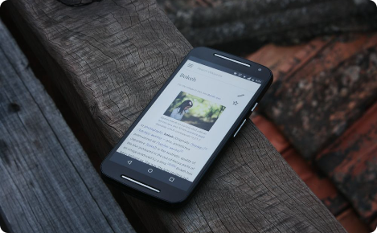

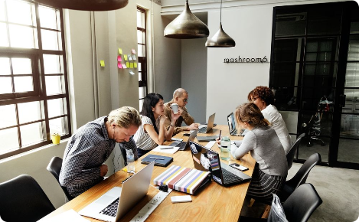
Introduction
Streamlined Scheduling
Time Management
Improved Collaboration
Effortlessly check real-time availability, book meeting rooms, and receive notifications through our user-friendly interface.
Maximize productivity by saving time and reducing conflicts with an efficient system for managing meeting room reservations.
Facilitate seamless coordination and enhance teamwork with automated meeting room bookings and easy cancellation options.

Slide 4
Key Features
Real-time Availability
User-friendly Interface
Instantly check the availability of meeting rooms, ensuring you always find the perfect space for your discussions.
Experience hassle-free bookings and cancellations with our intuitive interface, designed to simplify the process.
Easy creation and organization of meetings
Options for various amenities
Create and organize your meetings on the go with our easy to use interface. Edit the meeting settings anytime if something more is required.
Flexible system for choosing your favorable amenities for your meeting room like Coffee machine, TV, WIFI Connections etc.

Slide 5

Benefits
1
Efficient Utilization
Optimize your meeting room resources, eliminating wasted space and ensuring maximum utilization.
2
Time-saving
Save precious time for both employees and administrators with streamlined booking and cancellation processes.
3
Conflict Reduction
Avoid double-bookings and scheduling conflicts, enhancing productivity and minimizing meeting disruptions.
4
Improved Productivity
Promote efficient collaboration and communication, enabling teams to focus on their core tasks and responsibilities.

Slide 6
Implementation
1
Software and Hardware Requirements
Discover the necessary software and hardware components to implement our automated meeting room booking system.
2
Integration with Existing Systems
Learn how our system seamlessly integrates with your current tools and devices, ensuring a smooth transition.
3
Testing and Training
Understand the importance of rigorous testing and comprehensive training to ensure successful implementation.

Slide 7
Some Important pages

Slide 8
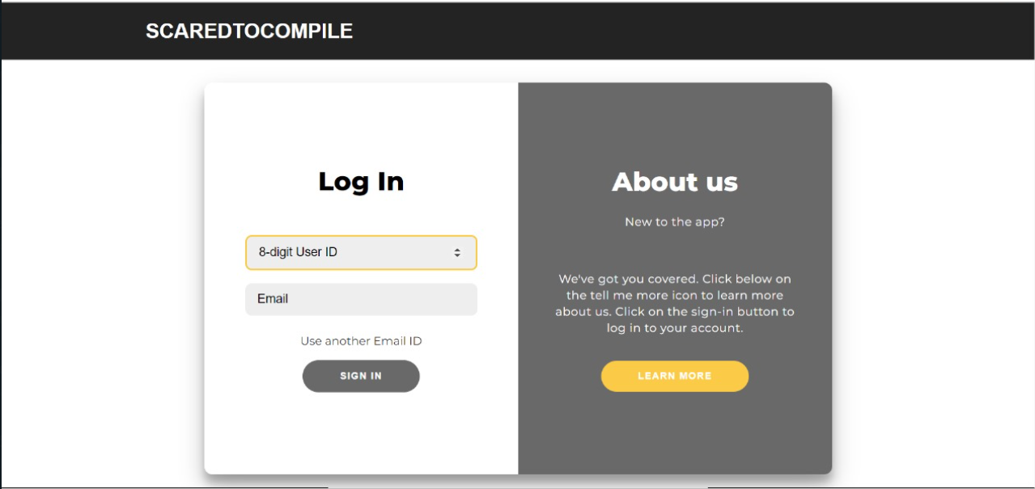
Log-In page

Slide 9
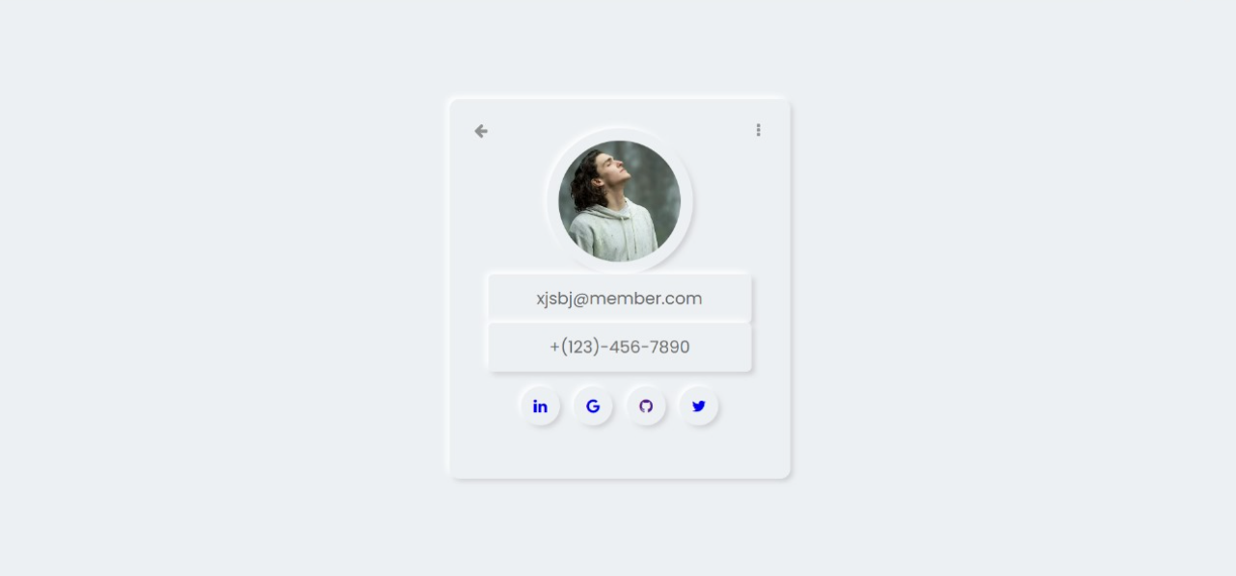
User Profile Page

Slide 10
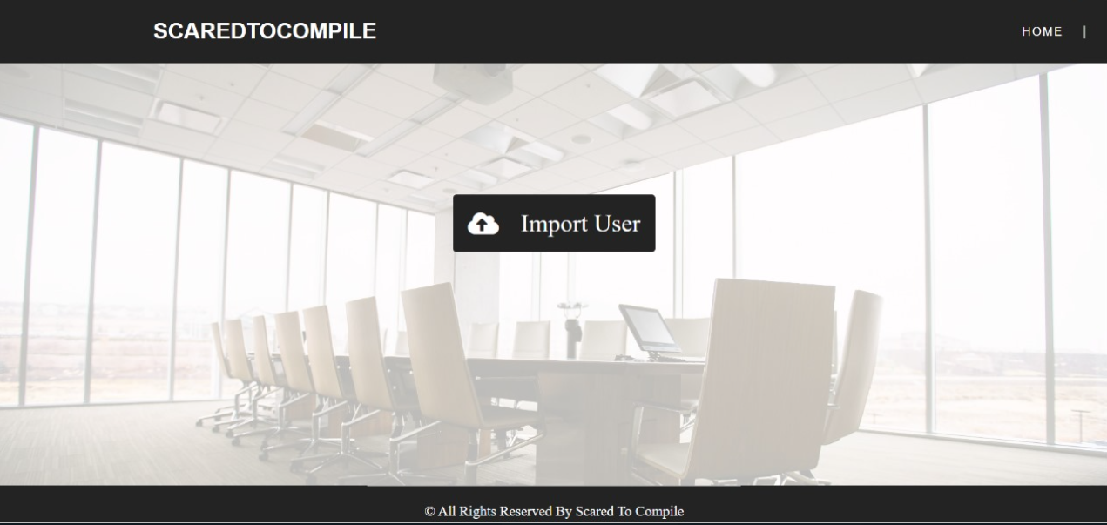
Organize meeting page

Slide 11
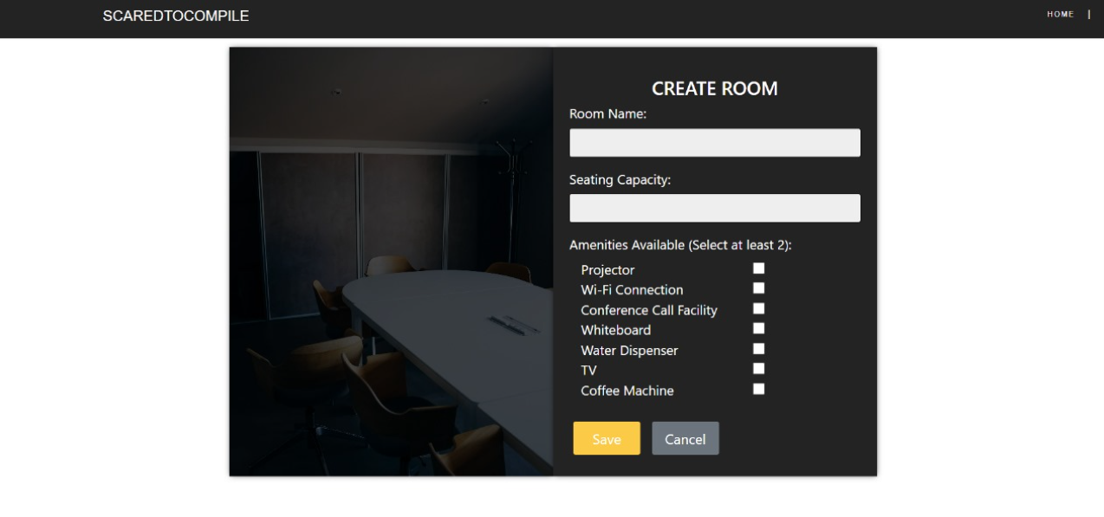
Create Room Page

Slide 12
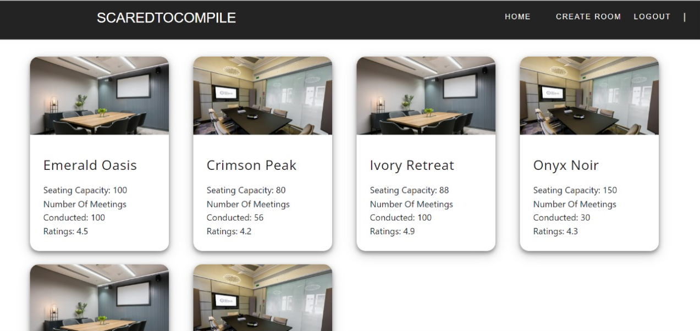
Admin page

Slide 13
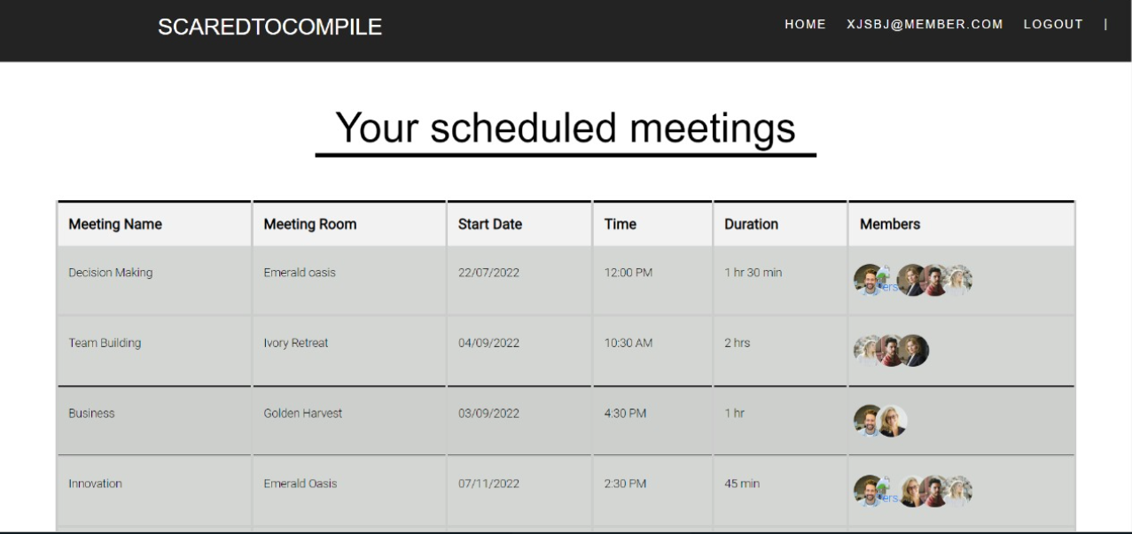
Members page

Slide 14

Conclusion
1
Summary of Benefits
Our application is designed to streamline meeting management and enhance collaboration within your organization. Key features include creating meeting rooms, organizing meetings, editing meetings, and providing separate pages for admins, managers, and members. Additionally, we have implemented a credit system based on user types. Experience seamless and efficient meetings with our innovative application.
2
The Future Ahead
Reflect on the potential advancements and exciting possibilities in the future of automated meeting room booking systems potentially using latest technologies like machine learning, Virtual reality to provide a next level of user experience in meetings.

